Slide 1
Servlet
A servlet is a Java programming language class that is used to extend the capabilities of servers that host applications accessed by means of a request-response programming model.
Servlets provide a component-based, platform-independent method for building Webbased applications, without the performance limitations of CGI programs.
Although servlets can respond to any type of request, they are commonly used to extend the applications hosted by web servers.
For such applications, Java Servlet technology defines HTTP-specific servlet classes.
Servlet is an interface that must be implemented for creating any Servlet.
The servlet is invoked when a form on a web page is submitted.

Slide 2
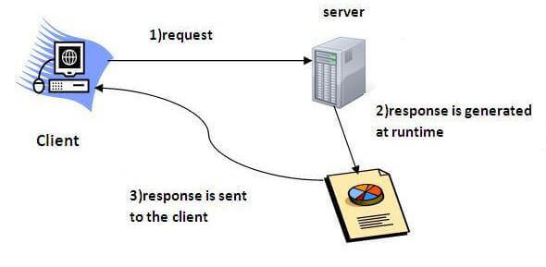

Slide 3
Life Cycle Of The Servlet
A servlet life cycle can be defined as the entire process from its creation till the destruction.
Life cycle of the servlet:
Servlet class is loaded.
Servlet instance is created.
init method is invoked.
service method is invoked.
destroy method is invoked.

Slide 4
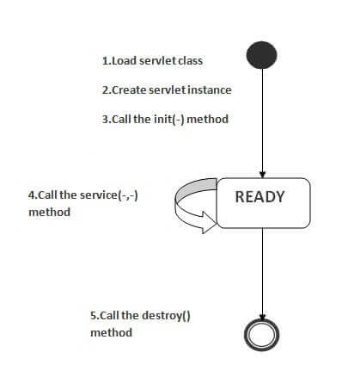

Slide 5
Contd…
There are three states of a servlet: new, ready and end.
The servlet is in new state if servlet instance is created.
After invoking the init() method, Servlet comes in the ready state.
In the ready state, servlet performs all the tasks.
the web container invokes the destroy() method, it shifts to the end state.

Slide 6
1) Servlet class is loaded
The classloader is responsible to load the servlet class.
The servlet class is loaded when the first request for the servlet is received by the web container.
2) Servlet instance is created
The web container creates the instance of a servlet after loading the servlet class.
The servlet instance is created only once in the servlet life cycle.
3) init method is invoked
The web container calls the init method only once after creating the servlet instance.

Slide 7
Contd…
The init method is used to initialize the servlet.
The servlet is normally created when a user first invokes a URL corresponding to the servlet
The init() method simply creates or loads some data that will be used throughout the life of the servlet.
It is the life cycle method of the javax.servlet.Servlet interface.
Syntax of the init method is given below:
public void init(ServletConfig config) throws ServletException
4) service method is invoked
The web container calls the service method each time when request for the servlet is received.
The service() method is the main method to perform the actual task.

Slide 8
Contd…
The servlet container (i.e. web server) calls the service() method to handle requests coming from the client( browsers) and to write the formatted response back to the client.
Each time the server receives a request for a servlet, the server produce a new thread and calls service.
The service() method checks the HTTP request type (GET, POST, PUT, DELETE, etc.) and calls doGet, doPost, doPut, doDelete, etc.
If servlet is initialized, it calls the service method. servlet is initialized only once.
The syntax of the service method of the Servlet interface is given below:
public void service(ServletRequest request, ServletResponse response)
throws ServletException, IOException

Slide 9
Contd…
5) destroy method is invoked
The web container calls the destroy method before removing the servlet instance from the service.
The destroy() method is called only once at the end of the life cycle of a servlet.
This method gives your servlet a chance to close database connections, halt background threads, write cookie lists or hit counts to disk, and perform other such cleanup activities.
After the destroy() method is called, the servlet object is marked for garbage collection.
The syntax of the destroy method of the Servlet interface is given below:
public void destroy()

Slide 10
The Servlet Can Be Created By Three Ways
The servlet example can be created by three ways:
By implementing Servlet interface,
By inheriting GenericServlet class, (or)
By inheriting HttpServlet class
The mostly used approach is by extending HttpServlet because it provides http request specific method such as doGet(), doPost(), doHead() etc.

Slide 11
Servlet Deployment
For using apache tomcat server. The deployment steps are as follows:
Create a directory structure
Create and Compile the Servlet. Then, copy the servlet’s class file to the proper directory, and add the servlet’s name and mapping to the proper web.xml file
Create a deployment descriptor
Start the server and deploy the project
Access the servlet

Slide 12
Web.xml
<web-app>
<servlet>
<servlet-name>HelloWorld</servlet-name>
<servlet-class>HelloWorld</servlet-class>
</servlet>
<servlet-mapping>
<servlet-name>HelloWorld</servlet-name>
<url-pattern>/HelloWorld</url-pattern>
</servlet-mapping></web-app>

Slide 13
import javax.servlet.http.*;
import javax.servlet.*;
import java.io.*;
public class DemoServlet extends HttpServlet {
public void doGet(HttpServletRequest req,HttpServletResponse res)
throws ServletException,IOException
{
res.setContentType("text/html");//setting the content type
PrintWriter pw=res.getWriter();//get the stream to write the data
//writing html in the stream
pw.println("<html><body>");
pw.println("Welcome to servlet");
pw.println("</body></html>");
pw.close();//closing the stream
}}

Slide 14
Difference Between JSP and Servlet:
Servlet is html in java whereas JSP is java in html.
Servlets run faster compared to JSP and JSP can be compiled into Java Servlets
It’s easier to code in JSP than in Java Servlets
JSP is a webpage scripting language that can generate dynamic content while Servlets are Java programs that are already compiled which also creates dynamic web content
JSP are generally preferred when there is not much processing of data required. But servlets are best for use when there is more processing and manipulation involved.
In JSP, we can build custom tags which can directly call Java beans. There is no such facility in servlets.
We can achieve functionality of JSP at client side by running JavaScript at client side. There are no such methods for servlets.
A servlet is like any other Java class. we put HTML into print statements like you use System.out or how JavaScript uses document.write.

Slide 15
Servlet API
Servlets are the Java programs that run on the Java-enabled web server or application server.
They are used to handle the request obtained from the webserver, process the request, produce the response, then send a response back to the webserver.
To create Java Servlets, we need to use Servlet API which contains all the necessary interfaces and classes.
Servlet API has 2 packages namely,
javax.servlet
javax.servlet.http
The javax.servlet and javax.servlet.http packages represent interfaces and classes for servlet api.

Slide 16
javax.servlet
This package provides the number of interfaces and classes to support Generic servlet which is protocol independent.(that establish the framework in which servlets operate)
These interfaces and classes describe and define the contracts between a servlet class and the runtime environment provided by a servlet container.
All servlets must implement this interface or extend a class that implements the interface. The ServletRequest and ServletResponse interfaces are also very important.

Slide 17
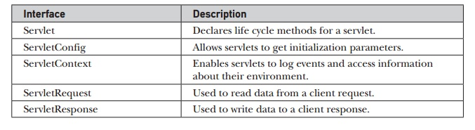

Slide 18
Classes available in javax.servlet package:
Class Name | Description
GenericServlet | To define a generic and protocol-independent servlet.
ServletContextAttributeEvent | To generate notifications about changes to the attributes of the servlet context of a web application.
ServletContextEvent | To generate notifications about changes to the servlet context of a web application.
ServletInputStream | This class provides an input stream to read binary data from a client request.
ServletOutputStream | This class provides an output stream for sending binary data to the client.
ServletRequestAttributeEvent | To generate notifications about changes to the attributes of the servlet request in an application.
ServletRequestEvent | To indicate lifecycle events for a ServletRequest.
ServletRequestWrapper | This class provides the implementation of the ServletRequest interface that can be subclassed by developers to adapt the request to a Servlet.
ServletResponseWrapper | This class provides the implementation of the ServletResponse interface that can be subclassed by developers to adapt the response from a Servlet.

Slide 19
The Servlet Interface
All servlets must implement the Servlet interface.
Servlet interface needs to be implemented for creating any servlet (either directly or indirectly).
It provides 3 life cycle methods that are used to initialize the servlet, to service the requests, and to destroy the servlet and 2 non-life cycle methods.
It declares the init( ), service( ), and destroy( ) methods that are called by the server during the life cycle of a servlet.
A method is also provided that allows a servlet to obtain any initialization parameters.
The init( ), service( ), and destroy( ) methods are the life cycle methods of the servlet.

Slide 20
Contd…
These are invoked by the server. The getServletConfig( ) method is called by the servlet to obtain initialization parameters.
A servlet developer overrides the getServletInfo( ) method to provide a string with useful information (for example, the version number). This method is also invoked by the server.

Slide 21
Method | Description
public void init(ServletConfig config) | initializes the servlet. It is the life cycle method of servlet and invoked by the web container only once.
public void service(ServletRequest request,ServletResponse response) | provides response for the incoming request. It is invoked at each request by the web container.
public void destroy() | is invoked only once and indicates that servlet is being destroyed.
public ServletConfig getServletConfig() | returns the object of ServletConfig.
public String getServletInfo() | returns information about servlet such as writer, copyright, version etc.

Slide 22
import java.io.*;
import javax.servlet.*;
public class First implements Servlet{
ServletConfig config=null;
public void init(ServletConfig config){
this.config=config;
System.out.println("servlet is initialized");
}
public void service(ServletRequest req,ServletResponse res)
throws IOException,ServletException{
res.setContentType("text/html");
PrintWriter out=res.getWriter();
out.print("<html><body>");
out.print("<b>hello simple servlet</b>");
out.print("</body></html>");
}
public void destroy(){System.out.println("servlet is destroyed");}
public ServletConfig getServletConfig(){return config;}
public String getServletInfo(){return "copyright 2007-1010";}
}

Slide 23
GenericServlet Class
Servlet API provides GenericServlet class in javax.servlet package.
An abstract class that implements most of the servlet basic methods.
Implements the Servlet, ServletConfig, and Serializable interfaces.
Protocol-independent servlet.
It not provides the implementation of service method.
Makes writing servlets easier by providing simple versions of the lifecycle methods init() and destroy().
To write a generic servlet, you need to extend javax.servlet.GenericServlet class and need to override the abstract service() method.

Slide 24
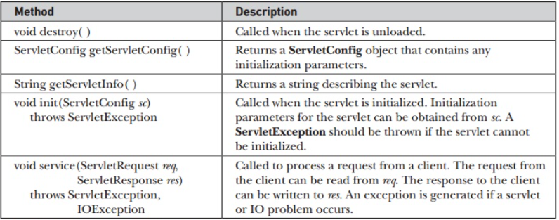

Slide 25
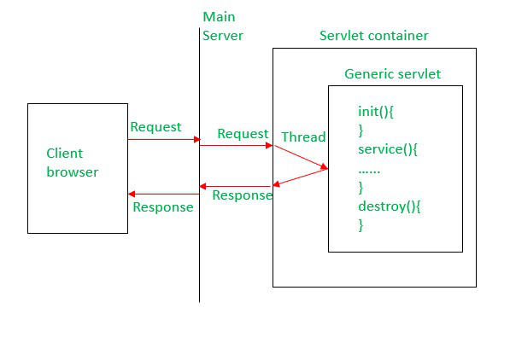

Slide 26
Contd…
public abstract class GenericServlet
extends java.lang.Object
implements Servlet, ServletConfig, java.io.Serializable

Slide 27
import java.io.IOException;
import java.io.PrintWriter;
import javax.servlet.*;
public class HelloWorld extends GenericServlet {
@Override
public void service(ServletRequest request, ServletResponse response)
throws ServletException, IOException {
response.setContentType("text/html");
PrintWriter out = response.getWriter();
out.println("<h1>Hello World example using" +
" GenericServlet class.</h1>");
out.close();
}
}

Slide 28
Reading Servlet Parameters
The ServletRequest interface includes methods that allow you to read the names and values of parameters that are included in a client request.
We will develop a servlet that illustrates their use.
The service( ) method is overridden to process client requests.
The getParameterNames( ) method returns an enumeration of the parameter names.
These are processed in a loop. You can see that the parameter name and value are output to the client.
The parameter value is obtained via the getParameter( ) method.

Slide 29
import java.io.*;
import java.util.*;
import javax.servlet.*;
public class PostParametersServlet extends GenericServlet {
public void service(ServletRequest request, ServletResponse response) throws ServletException, IOException {
PrintWriter pw = response.getWriter();
//Get enumeration of parameter names.
Enumeration e = request.getParameterNames();
//Display parameter names and values.
while(e.hasMoreElements()) {
String pname = (String)e.nextElement(); pw.print(pname + " = ");
String pvalue = request.getParameter(pname);
pw.println(pvalue);
}
pw.close(); }

Slide 30
javax.servlet.http
This package provides the number of interfaces and classes to support HTTP servlet which is HTTP protocol dependent.
These interfaces and classes describe and define the contracts between a servlet class running under HTTP protocol and the runtime environment provided by a servlet container.

Slide 31
Classes available in javax.servlet.http package:
Class Name | Description
Cookie | Creates a cookie object. It is a small amount of information sent by a servlet to a Web browser, saved by the browser, and later sent back to the server used for session management.
HttpServlet | Provides an abstract class that defines methods to create an HTTP suitable servlet for a web application.
HttpServletRequestWrapper | This class provides implementation of the HttpServletRequest interface that can be subclassed to adapt the request to a Servlet.
HttpServletResponseWrapper | This class provides implementation of the HttpServletResponse interface that can be subclassed to adapt the response from a Servlet.
HttpSessionBindingEvent | This events are either sent to an object that implements HttpSessionBindingListener when it is bound or unbound from a session, or to a HttpSessionAttributeListener that has been configured in the deployment descriptor when any attribute is bound, unbound or replaced in a session.
HttpSessionEvent | To represent event notifications for changes to sessions within a web application.

Slide 32
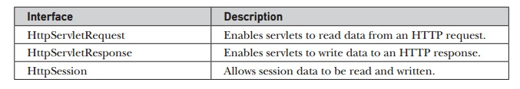

Slide 33
HttpServlet Class
Servlet API provides HttpServlet class in javax.servlet.http package.
An abstract class to be subclassed to create an HTTP-specific servlet that is suitable for a Web site/Web application.
HttpServlet class extends the GenericServlet and implements Serializable interface.
It is protocol-dependent.

Slide 34
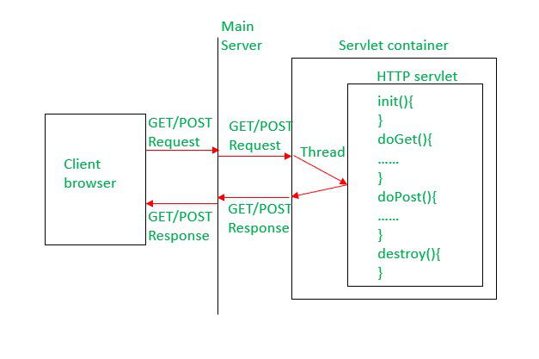

Slide 35
Contd…
public abstract class HttpServlet
extends GenericServlet
implements java.io.Serializable

Slide 36
Contd…
To write a Http servlet, you need to extend javax.servlet.http.HttpServlet class and must override at least one of the below methods,
doGet() – to support HTTP GET requests by the servlet.
doPost() – to support HTTP POST requests by the servlet.
doPut() – to support HTTP PUT requests by the servlet.
doDelete() – to support HTTP DELETE requests by the servlet.
init() and destroy() – to manage resources held in the life of the servlet.
getServletInfo() – To provide information about the servlet itself like the author of servlet or version of it etc.

Slide 37
Index.html
<html><body>
<form action="welcome" method="get">
Enter your name<input type="text" name="name"><br>
<input type="submit" value="login"></form>
</body></html>
DemoServ.java
import javax.servlet.http.*;
import javax.servlet.*;
import java.io.*;
public class DemoServ extends HttpServlet{
public void doGet(HttpServletRequest req,HttpServletResponse res)throws ServletException,IOException
{
res.setContentType("text/html");
PrintWriter pw=res.getWriter();
String name=req.getParameter("name");
pw.println("Welcome "+name);
}}

Slide 38
Handling HTTP Requests And Responses
The HttpServlet class provides specialized methods that handle the various types of HTTP requests.
A servlet developer typically overrides one of these methods.
These methods are doDelete( ), doGet( ), doHead( ), doOptions( ), doPost( ), doPut( ), and doTrace( ).
However, the GET and POST requests are commonly used when handling form input.
HTTP works as a request-response protocol between a client and server.
A client (browser) sends an HTTP request to the server; then the server returns a response to the client.
The response contains status information about the request and may also contain the requested content.

Slide 39
Handling HTTP GET Requests
The servlet is invoked when a form on a web page is submitted.
It defines a form that contains a select element and a submit button.
The action parameter of the form tag specifies a URL. The URL identifies a servlet to process the HTTP GET request.
The doGet( ) method is overridden to process any HTTP GET requests that are sent to this servlet.
It uses the getParameter( ) method of HttpServletRequest to obtain the selection that was made by the user. A response is then formulated.

Slide 40
Handling HTTP Response
Implements the ServletResponse interface to provide HTTP-specific functionality in sending a response.
It is an interface that acts as a wrapper of the output stream of a servlet and of its length and type.
For example, it has methods to access HTTP headers and cookies.
The servlet container creates an HttpServletResponse object and passes it as an argument to the servlet’s service methods ( doGet , doPost , etc).
The class HttpServletResponse defines the getWriter method. setContentType sets the content type of the response being sent to the client.

Slide 41
Contd…
Methods:
– String setContentLength(); Sets the length of the content body in the response In HTTP servlets, this method sets the HTTP Content-Length header.
– String setContentType(); (Inherited) Sets the content type of the response being sent to the client.
– void setHeader(String name, String value); Sets a response header with the given name and value.
– Writer getWriter(); (Inherited) Returns a PrintWriter object that can send character text to the client.

Slide 42
Session Tracking
HTTP is a stateless protocol. Each request is independent of the previous one.
However, in some applications, it is necessary to save state information so that information can be collected from several interactions between a browser and a server.
Sessions provide such a mechanism.
A session can be created via the getSession( ) method of HttpServletRequest.
An HttpSession object is returned. This object can store a set of bindings that associate names with objects.
The getSession( ) method gets the current session. A new session is created if one does not already exist.

Slide 43
Contd…
The setAttribute( ), getAttribute( ), getAttributeNames( ), and removeAttribute( ) methods of HttpSession manage these bindings.
Session state is shared by all servlets that are associated with a client.

Slide 44
4) HttpSession Interface
servlet provides HttpSession Interface which provides a way to identify a user across more than one page request and to store information about that user.
The servlet container uses this interface to create a session between an HTTP client and an HTTP server.
The session persists for a specified time period, across more than one connection or page request from the user.
The container creates a session id for each user. The container uses this id to identify the particular user. An object of HttpSession can be used to perform two tasks:
-bind objects
-view and manipulate information about a session, such as the session identifier, creation time, and last accessed time.

Slide 45
Contd…
Example
String n=request.getParameter("userName");
out.print("Welcome "+n);
HttpSession session=request.getSession();
session.setAttribute("uname",n);

Slide 46
import java.io.*;
import java.util.*;
import javax.servlet.*;
import javax.servlet.http.*;
public class DateServlet extends HttpServlet {
public void doGet(HttpServletRequest request, HttpServletResponse response)
throws ServletException, IOException {
HttpSession hs = request.getSession(true);
response.setContentType("text/html");
PrintWriter pw = response.getWriter(); pw.print("<B>");
Date date = (Date)hs.getAttribute("date");
if(date != null) {
pw.print("Last access: " + date + "<br>");
}
date = new Date();
hs.setAttribute("date", date);
pw.println("Current date: " + date);
}}

Slide 47
Cookies in Servlet
A cookie is a small piece of information that is persisted between the multiple client requests.
A cookie has a name, a single value, and optional attributes such as a comment, path and domain qualifiers, a maximum age, and a version number.
To store information in cookie. we creates a Cookie object that has the name and the value.
The cookie is then added to the header of the HTTP response via the addCookie( ) method.
It invokes the getCookies( ) method to read any cookies that are included in the HTTP GET request.
The names and values of these cookies are then written to the HTTP response. Observe that the getName( ) and getValue( ) methods are called to obtain this information.
Cookie is save in client machine

Slide 48
Contd…
Expiration time of cookie can set by setMaxAge( ) method of Cookie. Therefore, the cookie expires when the browser session ends.
Example:
Cookie ck=new Cookie("user","binod");//creating cookie object
ck.setMaxAge(60 * 60 * 24); require in seconds set up a cookie for 24 hours
response.addCookie(ck);//adding cookie in the http response header
Cookie[] cookies = request.getCookies();//get cookie array
Cookie cookie = cookies[i];
String name =cookie.getName();
String value =cookie.getValue();

Slide 49
Contd…
Advantage of Cookies
Simplest technique of maintaining the state. Cookies are maintained at client side.
Disadvantage of Cookies
It will not work if cookie is disabled from the browser.
Only textual information can be set in Cookie object

Slide 50
import java.io.*; import javax.servlet.*;
import javax.servlet.http.*;
public class HelloForm extends HttpServlet {
public void doGet(HttpServletRequest request, HttpServletResponse response)throws ServletException, IOException {
Cookie firstName = new Cookie("first_name", request.getParameter("first_name"));
firstName.setMaxAge(60*60*24);
response.addCookie( firstName );
response.setContentType("text/html");
PrintWriter out = response.getWriter();
String title = "Setting Cookies Example";
String docType = "<!doctype html public \"-//w3c//dtd html 4.0 " + "transitional//en\">\n";
out.println(docType + "<html>\n" + "<head> <title>" + title + "</title></head>\n" +
"<body bgcolor = \"#f0f0f0\">\n" +
"<h1 align = \"center\">" + title + "</h1>\n" +
"<ul>\n" + " <li><b>First Name</b>: "+ request.getParameter("first_name") + "\n" +
"</ul>\n" +
"</body></html>"
); }}

Slide 51
Session Tracking Techniques
There are four techniques used in Session tracking:
Cookies
Hidden Form Field
URL Rewriting
HttpSession

Slide 52
2) Hidden Form Field
A hidden (invisible) textfield is used for maintaining the state of an user.
We store the information in the hidden field and get it from another servlet. This approach is better if we have to submit form in all the pages and we don't want to depend on the browser.
Exampl: <input type="hidden" name="uname" value=“Ram">
Advantage of Hidden Form Field
It will always work whether cookie is disabled or not.
Disadvantage of Hidden Form Field:
It is maintained at server side. Extra form submission is required on each pages.
Only textual information can be used.

Slide 53
import java.io.*;
import javax.servlet.*;
import javax.servlet.http.*;
public class FirstServlet extends HttpServlet {
public void doGet(HttpServletRequest request, HttpServletResponse response){
try{
response.setContentType("text/html");
PrintWriter out = response.getWriter();
String n="hello_hidden";
//creating form that have invisible textfield
out.print("<form action='servlet2'>");
out.print("<input type='hidden' name='uname' value='"+n+"'>");
out.print("<input type='submit' value='go'>");
out.print("</form>");
out.close();
}catch(Exception e){System.out.println(e);}
}
}

Slide 54
import java.io.*;
import javax.servlet.*;
import javax.servlet.http.*;
public class SecondServlet extends HttpServlet {
public void doGet(HttpServletRequest request, HttpServletResponse response)
try{
response.setContentType("text/html");
PrintWriter out = response.getWriter();
//Getting the value from the hidden field
String n=request.getParameter("uname");
out.print("Hello "+n);
out.close();
}
catch(Exception e){System.out.println(e);}
}
}

Slide 55
3) URL rewriting
we append a token or identifier to the URL of the next Servlet or the next resource. We can send parameter name/value pairs using the following format:
url?name1=value1&name2=value2&??
Parameters are separated using the ampersand(&). When the user clicks the hyperlink, the parameter name/value pairs will be passed to the server. From a Servlet, we can use getParameter() method to obtain a parameter value.
Advantage of URL Rewriting
It will always work whether cookie is disabled or not (browser independent).
Extra form submission is not required on each pages.
Disadvantage of URL Rewriting
It will work only with links. It can send only textual information.

Slide 56
import java.io.*;
import javax.servlet.*;
import javax.servlet.http.*;
public class FirstServlet extends HttpServlet {
public void doGet(HttpServletRequest request, HttpServletResponse response){
try{
response.setContentType("text/html");
PrintWriter out = response.getWriter();
//getting value from the query string
out.print("<a href='servlet2?uname=testuser'>visit</a>");
out.close();
}
catch(Exception e){System.out.println(e);}
}
}

Slide 57
import java.io.*;
import javax.servlet.*;
import javax.servlet.http.*;
public class SecondServlet extends HttpServlet {
public void doGet(HttpServletRequest request, HttpServletResponse response)
try{
response.setContentType("text/html");
PrintWriter out = response.getWriter();
//getting value from the query string
String n=request.getParameter("uname");
out.print("Hello "+n);
out.close();
}
catch(Exception e){System.out.println(e);}
}}

Slide 58
JSP(Java Server Pages)
It is a technology for developing web pages that support dynamic content which helps developers insert java code in HTML pages by making use of special JSP tags, most of which start with <% and end with %>.
A JavaServer Pages component is a type of Java servlet that is designed to fulfill the role of a user interface for a Java web application.
Web developers write JSPs as text files that combine HTML or XHTML code, XML elements, and embedded JSP actions and commands.
Java Servlets are programs that run on a Web or Application server and act as a middle layer between a request coming from a Web browser or other HTTP client and databases or applications on the HTTP server.

Slide 59
Contd…
JSP technology is used to create web application just like Servlet technology.
It can be thought of as an extension to servlet because it provides more functionality than servlet such as expression language, jstl etc
JavaServer Pages (JSP) technology provides a simplified, fast way to create dynamic web content.
JSP technology enables rapid development of web-based applications that are server- and platform-independent

Slide 60
Elements Of JSP
The Scriptlet
A scriptlet can contain any number of JAVA language statements, variable or method declarations, or expressions that are valid in the page scripting language.
<% code fragment %>
<html>
<head><title>Hello World</title></head>
<body>
Hello World!<br/>
<% out.println("Your IP address is " + request.getRemoteAddr()); %>
</body></html>

Slide 61
Contd…
SP Declarations
A declaration declares one or more variables or methods that we can use in Java code later in the JSP file.
The JSP declaration tag is used to declare fields and methods
we must declare the variable or method before you use it in the JSP file.
<%! declaration; [ declaration; ]+ ... %>
<html>
<body>
<%! int data=50; %>
<%= "Value of the variable is:"+data %>
</body> </html>

Slide 62
Contd…
JSP Expression
A JSP expression element contains a scripting language expression that is evaluated, converted to a String, and inserted where the expression appears in the JSP file
Because the value of an expression is converted to a String, you can use an expression within a line of text, whether or not it is tagged with HTML, in a JSP file.
The expression element can contain any expression that is valid according to the Java Language Specification but you cannot use a semicolon to end an expression.
<%= expression %>

Slide 63
Contd…
<html>
<head><title>A Comment Test</title></head>
<body>
<p>Today's date: <%= (new java.util.Date()).toLocaleString()%></p>
</body>
</html>

Slide 64
Contd…
JSP Comments
JSP comment marks text or statements that the JSP container should ignore. A JSP comment is useful when you want to hide or "comment out", a part of your JSP page.
<%-- This is JSP comment --%>
<html>
<head><title>A Comment Test</title></head>
<body>
<h2>A Test of Comments</h2>
<%-- This comment will not be visible in the page source --%>
</body></html>

Slide 65
Contd…
JSP Directives
A JSP directive affects the overall structure of the servlet class. It usually has the following form −
<%@ directive attribute="value" %>
<%@ page ... %>
Defines page-dependent attributes, such as scripting language, error page, and buffering requirements.
<%@ include ... %>
Includes a file during the translation phase.
<%@ taglib ... %>
Declares a tag library, containing custom actions, used in the page

Slide 66
JSP Comments
JSP comment marks text or statements that the JSP container should ignore. A JSP comment is useful when you want to hide or "comment out", a part of your JSP page.
<%-- This is JSP comment --%>
<html>
<head><title>A Comment Test</title></head>
<body>
<h2>A Test of Comments</h2>
<%-- This comment will not be visible in the page source --%>
</body></html>

Slide 67
JSP Directives
A JSP directive affects the overall structure of the servlet class. It usually has the following form −
<%@ directive attribute="value" %>
<%@ page ... %>
The page directive defines attributes that apply to an entire JSP page
Defines page-dependent attributes, such as scripting language, error page, and buffering requirements.
<html>
<body>
<%@ page import="java.util.Date" %>
Today is: <%= new Date() %>
</body> </html>

Slide 68
<%@ include ... %>
Includes a file during the translation phase. The include directive is used to include the contents of any resource it may be jsp file, html file or text file.
The include directive includes the original content of the included resource at page translation time
<html>
<body>
<%@ include file="header.html" %>
Today is: <%= java.util.Calendar.getInstance().getTime() %>
</body> </html>

Slide 69
<%@ taglib ... %>
Declares a tag library, containing custom actions, used in the page
The JSP taglib directive is used to define a tag library that defines many tags. We use the TLD (Tag Library Descriptor) file to define the tags.
<html>
<body>
<%@ taglib uri="http://www.javatpoint.com/tags" prefix="mytag" %>
<mytag:currentDate/>
</body>
</html>

Slide 70
JSP Implicit Objects
These objects are created by the web container that are available to all the jsp pages.
These Objects are the Java objects that the JSP Container makes available to the developers in each page and the developer can call them directly without being explicitly declared.
JSP Implicit Objects are also called pre-defined variables.

Slide 71
Object | Description
request | It is HttpServletRequest object associated with the request.
response | It is HttpServletResponse object associated with the response to the client.
out | It is PrintWriter object used to send output to the client.Methods(out.print(dataType dt), out.println(dataType dt), out.flush())
session | It is HttpSession object associated with the request.
application | It is ServletContext object associated with the application context.
config | It is ServletConfig object associated with the page.
pageContext | This encapsulates use of server-specific features like higher performance JspWriters.
page | This is simply a synonym for this, and is used to call the methods defined by the translated servlet class.
Exception | The Exception object allows the exception data to be accessed by designated JSP.

Slide 72
Example Of Out Implicit Object
<html>
<body>
<% out.print("Today is:"+java.util.Calendar.getInstance().getTime()); %>
</body>
</html>

Slide 73
Scope Of JSP Objects
The availability of a JSP object for use from a particular place of the application is defined as the scope of that JSP object.
Every object created in a JSP page will have a scope. Object scope in JSP is segregated into four parts and they are page, request, session and application.
page ‘page’ scope means, the JSP object can be accessed only from within the same page where it was created. The default scope for JSP objects created using <jsp:useBean> tag is page.
request A JSP object created using the ‘request’ scope can be accessed from any pages that serves that request. More than one page can serve a single request.
The JSP object will be bound to the request object. Implicit object request has the ‘request’ scope

Slide 74
Contd…
session ‘session’ scope means, the JSP object is accessible from pages that belong to the same session from where it was created.
The JSP object that is created using the session scope is bound to the session object. Implicit object session has the ‘session’ scope.
application A JSP object created using the ‘application’ scope can be accessed from any pages across the application.
The JSP object is bound to the application object. Implicit object application has the ‘application’ scope.

Slide 75
Processing Forms
When we need to pass some information from browser to the web server and ultimately to backend program.
The browser uses two methods to pass this information to the web server.
These methods are the GET Method and the POST Method.
The GET method is the default method to pass information from the browser to the web server and it produces a long string
Methods in Form Processing
GET method
The GET method sends the encoded user information appended to the page request. The page and the encoded information are separated by the ? character as follows −
http://www.test.com/hello?key1=value1&key2=value2

Slide 76
Contd…
This information is passed using QUERY_STRING header.
which can be handled using getQueryString() and getParameter() methods of request object
http://localhost:8080/main.jsp?first_name=ZARA&last_name=ALI
<html>
<head> <title>Using GET Method to Read Form Data</title> </head>
<body>
First Name: <%= request.getParameter("first_name")%>
Last Name: <%= request.getParameter("last_name")%>
</body>
</html>

Slide 77
POST method
A generally more reliable method of passing information to a backend program is the POST method.
This method packages the information similar to the GET method, but instead of sending it as a text string after a ? in the URL it sends it as a separate message.
JSP handles this type of requests using getParameter() method to read simple parameters and getInputStream() method to read binary data stream coming from the client.

Slide 78
<html>
<body>
<form action = "main.jsp" method = "GET">
First Name: <input type = "text" name = "first_name">
<br />
Last Name: <input type = "text" name = "last_name" />
<input type = "submit" value = "Submit" />
</form>
</body>
</html>
main.jsp
<html>
<head> <title>GET and POST Method to Read Form Data</title> </head>
<body>
First Name: <%= request.getParameter("first_name")%>
Last Name: <%= request.getParameter("last_name")%>
</body></html>

Slide 79
Java Server Pages Standard Tag Library (JSTL)
It is a collection of useful JSP tags which encapsulates the core functionality common to many JSP applications.
JSTL has support for common, structural tasks such as iteration and conditionals, tags for manipulating XML documents, internationalization tags, and SQL tags.
It also provides a framework for integrating the existing custom tags with the JSTL tags.
Classification of The JSTL Tags
Core Tags
Formatting tags
SQL tags
XML tags
JSTL Functions

Slide 80
Database Access With JSP
JSTL SQL tag library can be used to interact with database. Tab library provides tag to perform several operations on database.
To use SQL tag library on JSP page we need to import its tag library using
<%@ taglib prefix="sql" uri="http://java.sun.com/jsp/jstl/sql"%>
<sql:setDataSource>
we need to first create a datasource to provide all the required information about database so our application is aware about the database to connect.
This tag is used to configure all the required information about the database and save it in a scoped variable.

Slide 81
Following attributes are supported by this tag-
· driver- this attribute tells the driver class to be loaded and registered to interact with database.
· url- URL for the database connection
· user- username of Database
· password- password of Database
· var- variable to store datasource information
· scope- scope in which variable will be saved. Possible values are Page, request, session and application. Default value is Page.
<sql:setDataSource var="libraryDataSource" driver="com.mysql.jdbc.Driver"
url="jdbc:mysql://localhost:3306/LIBRARY"
user="user_id" password="password"
scope=”page | application | session | request”
/>

Slide 82
<sql:query> and <sql:update>
This tag is used to fire the select query and saves the result in scoped variable.
Following attributes are supported by this tag-
· sql- to provide the select query. Alternatively we can add the select statement in body of tag
· datasource- database connection . This attribute should not be used with <sql:query> tag is used within <sql:transaction> tag
· var- variable to store result of query
· scope- scope in which variable will be saved. Possible values are Page ,request, session and application . Default value is Page
<sql:query var="booksQuery" datasource=”libraryDatasource”
scope=”page | application | session | request”>
select * from books;//delete from books;
</sql:query>

Slide 83
Java Web Framework
The most popular Java web frameworks are:
Spring
JSF(Java Server Faces)
GWT

Slide 84
Spring
Spring is a powerful, lightweight, and most popular framework which makes Java quicker, easier, and safer to use.
Spring Boot is an open source Java-based framework used to create a micro Service.
It is developed by Pivotal Team and is used to build stand-alone and production ready spring applications.
It is a complete programming model that is built on and with Java, starting with Spring Boot, which is a way to get a spring application up and running with minimal configuration and no application server required.
This framework is very popular among developers for its speed, simplicity, and productivity which helps to create enterprise-level web applications with complete ease.

Slide 85
Contd…
Spring MVC and Spring Boot made Java modern, reactive, and cloud-ready to build high-performance complex web applications hence used by many tech-giants, including Netflix, Amazon, Google, Microsoft, etc.

Slide 86
Spring Boot Features
Create stand-alone Spring applications
It provides a flexible way to configure Java Beans, XML configurations, and Database Transactions.
It provides a powerful batch processing and manages REST endpoints.
In Spring Boot, everything is auto configured; no manual configurations are needed.
It offers annotation-based spring application
Eases dependency management
It includes Embedded Servlet Container

Slide 87
Advantages
Spring Boot offers the following advantages to its developers −
Easy to understand and develop spring applications
Increases productivity
Reduces the development time
It tests web applications easily with the help of different Embedded HTTP servers such as Tomcat, Jetty, etc. We don't need to deploy WAR files
It creates stand-alone Spring applications that can be started using Java -jar.
It offers the number of plug-ins.
It increases productivity and reduces development time.

Slide 88
Limitations Of Spring Boot
Spring Boot can use dependencies that are not going to be used in the application. These dependencies increase the size of the application.

Slide 89
Spring Boot Starter Actuator Dependency
Its code is shown below −
<dependency>
<groupId>org.springframework.boot</groupId>
<artifactId>spring-boot-starter-actuator</artifactId>
</dependency>

Slide 90
Create a Simple Web Application
package com.example.springboot;
import org.springframework.web.bind.annotation.GetMapping;
import org.springframework.web.bind.annotation.RestController;
@RestController
public class HelloController {
@GetMapping("/")
public String index() {
return "Greetings from Spring Boot!";
}
}

Slide 91
The class is flagged as a @RestController, meaning it is ready for use by Spring MVC to handle web requests.
@GetMapping maps / to the index() method.
When invoked from a browser or by using curl on the command line, the method returns pure text.
That is because @RestController combines @Controller and @ResponseBody, two annotations that results in web requests returning data rather than a view.

Slide 92
package com.example.springboot;
import java.util.Arrays; import org.springframework.boot.*;
import org.springframework.boot.autoconfigure.SpringBootApplication;
import org.springframework.context.ApplicationContext;
import org.springframework.context.annotation.Bean;
@SpringBootApplication
public class Application {
public static void main(String[] args) {
SpringApplication.run(Application.class, args);
}
@Bean
public CommandLineRunner commandLineRunner(ApplicationContext ctx) {
return args -> {
System.out.println("Let's inspect the beans provided by Spring Boot:");
String[] beanNames = ctx.getBeanDefinitionNames();
Arrays.sort(beanNames);
for (String beanName : beanNames) {
System.out.println(beanName);
}};
}}

Slide 93
@SpringBootApplication is a convenience annotation that adds all of the following:
@Configuration: Tags the class as a source of bean definitions for the application context.
@EnableAutoConfiguration: Tells Spring Boot to start adding beans based on classpath settings, other beans, and various property settings.
if spring-webmvc is on the classpath, this annotation flags the application as a web application and activates key behaviors, such as setting up a DispatcherServlet.
@ComponentScan: Tells Spring to look for other components, configurations, and services in the com/example package, letting it find the controllers.
The main() method uses Spring Boot’s SpringApplication.run() method to launch an application.
There is also a CommandLineRunner method marked as a @Bean, and this runs on start up. It retrieves all the beans that were created by your application or that were automatically added by Spring Boot.

Slide 94
Run the Application
./gradlew bootRun
./mvnw spring-boot:run
Now run the service with curl (in a separate terminal window), by running the following command (shown with its output):
$ curl localhost:8080

Slide 95
If you use Maven, add the following to your pom.xml file:
<dependency>
<groupId>org.springframework.boot</groupId>
<artifactId>spring-boot-starter-test</artifactId>
<scope>test</scope>
</dependency>

Slide 96
JavaServer Faces (JSF)
It is quite similar to Struts, a free web application developed framework, maintained by Oracle technology which simplifies building user interfaces for Server-side applications by assembling reusable UI components in a page.
JSF is a component-based MVC framework that encapsulates various client-side technologies and focuses more on the presentation layer to allow web developers to create UI simply by just drag and drop.
Rich libraries and reusable UI components,
Easy front end tools to use without too much coding,
Jsf helps to improve productivity and consistency,
Enrich the user experience by adding Ajax events for validations and method invocations.
It provides an API to represent and manage UI components and instead of using Java, JSF uses XML for view handling.

Slide 97
A simple JSF application requires a Managed Bean, Facelet, and mapping the servlet.
package helloworld;
import javax.faces.bean.ManagedBean;
@ManagedBean
public class HelloWorld {
final String world = "Hello World!";
public String getworld()
{ return world; }
}
helloworld.xhtml
<html lang="en" xmlns_h="http://java.sun.com/jsf/html">
<h:head> <title>Facelets Hello World</title> </h:head>
<h:body> #{hello.world} </h:body>
</html>

Slide 98
GWT (Google Web Toolkit)
Google developed the Google Web Toolkit (GWT).
Google also had its hands-on with a web development framework for Java.
GWT Google web toolkit is fully featured and rich for all types of internet applications using Google APIs.
What makes GWT framework stand apart from others in the list is its ability to converts Java code into Javascript code as well as enabling customization options.
This feature saves a lot of time and you can easily get into final results without investing much time in testing apps.
We can create highly performing web apps in less time with this open-source collection of technologies.
Because Google web toolkit is compatible with various web development frameworks,

Slide 99
Contd…
It makes it easy to maintain complex JavaScript user interfaces with Java code.
GWT has lost some of its popularity over the last couple of years as more development teams are pushing Java to the backend and having it expose REST APIs which are consumed by both native mobile apps and user interfaces built in Node.js, using frameworks like Angular.

